Slide 1
Unit 2
What time do you
go to school?
Section B 2a-2c
七年级(下)

Slide 2
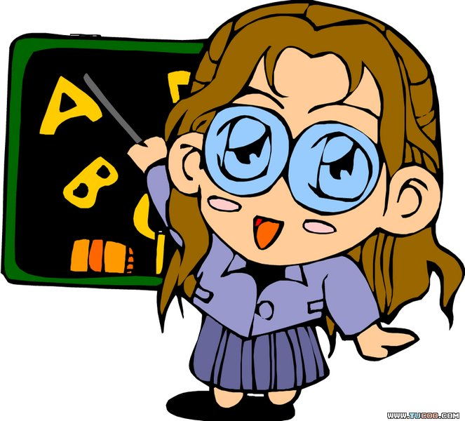
Objectives
To read the passage about the daily routines of Tony and Mary
To learn to distinguish healthy habits from unhealthy habits

Slide 3


2a
Check (√ ) the activities you think are healthy.
√
__ go to bed early __ eat ice-cream
__eat quickly __ eat vegetables
__ play sports __ take a walk
√
√
√
2b
Tony and Mary are brother and sister. They have healthy and unhealthy habits. Who is healthier? Circle the healthy activities.

Slide 4
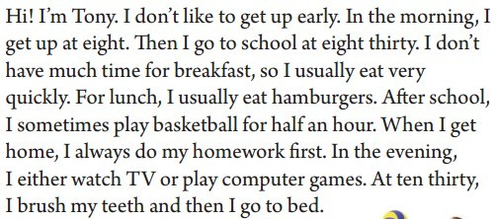
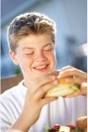

Slide 5
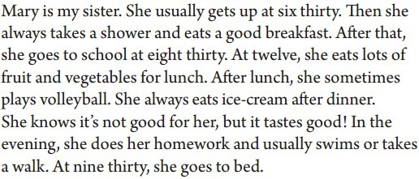
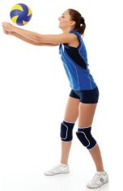

Slide 6

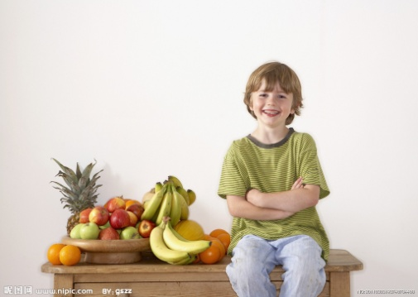
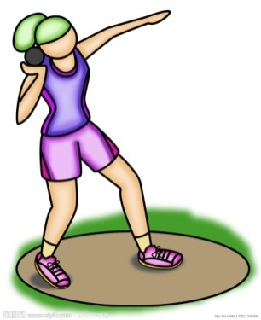
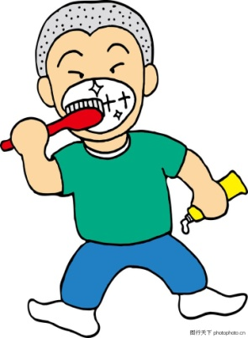
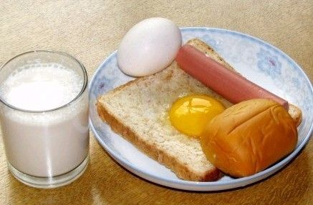
What other healthy activities
you know.
eat lots of fruit
exercise
brush teeth twice a day
eat a good breakfast

Slide 7
Read 2b again and fill in the blanks.
Time | Tony’s Activities
At eight | __________
 | eats a quick breakfast
At eight thirty | ________________
At noon | ________________
After school | ________________________________
 | __________________
in the evening At ten thirty | ______________________________
 | brushes teeth and goes to bed
gets up
goes to school
eats hamburgers
plays basketball for half an hour
does his homework
watches TV or plays computer games

Slide 8
Time | Mary’s Activities
____________ | gets up
 | takes a shower and eats a good breakfast
____________ | goes to school
At twelve | ____________________________
After lunch | ______________
 | ______________
in the evening At nine thirty | _________________________________________
 | goes to bed
At six thirty
At eight thirty
eats lots of fruit and vegetables
plays volleyball
eats ice-cream
does her homework, swims or takes a walk

Slide 9
2c Write down the unhealthy habits of each person. Then think of healthy activities for them.
 | Unhealthy habits | Healthy habits
Tony
Mary
not get up early
play basketball
eat quickly
brush teeth
eat a good
breakfast
eat ice-cream
take a walk

Slide 10
Language points
1. quickly的用法。
quickly意为“快速地”，是副词，修饰动词。
The dog runs quickly.
小狗快速地跑了。
Don’t eat quickly. It’s not a good habit.
别吃得太快，这不是个好习惯。

Slide 11
拓展：
quick adj. ，快的；迅速的。
Tom eats a quick breakfast, then goes to school.
汤姆快速吃完早饭，然后就去上学了。

Slide 12
2. either… or… 意为“或者……或者…… ” 连接两个并列名词、代词或句子成分。
Jack eats either hamburgers or sandwiches for lunch.
杰克午饭或者吃汉堡或者吃三明治。
You can either play chess or play the guitar.
你可以下棋或者弹吉他。

Slide 13
当either…or…连接两个名词作主语时，谓语动词的时态和数应与最近的一个相匹配。
Either you or he is right.
不是你对就是他对。

Slide 14
3. lots of 与many, much的用法
这三个词都有“许多；大量”之意，但
用法不同。
1) lots of ，后面可以跟可数名词也可以跟
不可数名词。如：
He doesn’t have lots of (=many) books.
We have lots of (=much) work to do.

Slide 15
2) many与可数名词复数形式连用。如：
There are many apples in the basket.
篮子里有许多苹果。
3) much表示数量时，只能修饰不可数名词。如：
We don’t have much milk.
我们的牛奶不多了。

Slide 16
4. She knows it’s not good for her, but it tastes good!
1) be good for …表示“对……有益；对……有好处”；
be bad for…表示“对……有害；对……有坏处”。

Slide 17
It’s good for our health to go to bed early
and get up early.
早睡早起对我们的健康有好处。
Don’t read in the dark. It’s bad for your
eyes.
不要在暗处看书，这对你的眼睛有害。

Slide 18
2) taste 意为“品尝……的味道”。是连系动词，后面常跟形容词。
Apples taste good. 苹果尝起来味道很好。
Does the ice-cream taste nice?
冰淇淋的味道尝起来很好吗？
拓展：taste作名词，意为“味道”。
The ice-cream has a taste of lemon.
冰淇淋有点柠檬的味道。

Slide 19
Quiz

Slide 20
一、根据提示用合适的单词填空。
round
1. I get up at a______ 6:00.
2. School s______ at 7:40.
3. He goes to school ____ _____________
(大约) 7:00.
4. Do you want to _____ ______ (了解)
my morning?
tarts
at around/about
know about

Slide 21
二、按要求改写句子。
1. He eats breakfast at 6:20. (改为否定句）
2. I want to know about her hobbies.
(一般疑问句）
He doesn’t eat breakfast at 6:20.
Do you know about her hobbies?
3. I usually get up at 6:00 in the morning.
(就划线部分提问）
What time do you usually get up?

Slide 22
三、翻译短语
1. 起床__________________________
2. 在7点30分_____________________
3. 吃早餐__________________________
4. 在…旁边______________________
5. 去上学________________________
6. 上课__________________________
7. 课间休息______________________
8. 与我的朋友交谈_______________
9. 去操场______________________
10. 踢足球_______________________
get up
at half past seven
have breakfast
next to
go to school
have classes
have a break
talk with my friends
go to the playground
play football

Slide 23
have lunch
in the dining hall
have meat and rice
go home
watch TV
have dinner
do one’s homework
go to bed
in the morning
in the afternoon
in the evening
11. 吃午饭____________________
12. 在食堂____________________
13. 吃肉和大米________________
14. 回家______________________
15. 看电视____________________
16. 吃晚饭____________________
17. 做功课____________________
18. 上床睡觉__________________
19. 在上午____________________
20. 在下午___________________
21. 在晚上____________________

Slide 24
四、翻译句子
1.谢谢你的帮助。
2.八点钟开始上课。
3.他父亲整夜工作。
Thanks for your help.
School starts at 8:00.
His father works all night.

Slide 25
4.我想去打篮球。
5.她每晚做家庭作业。
6.Mike经常把自己的学习情况告诉妈妈。
7.我想知道他的情况。
I want to play basketball.
She does her homework every evening.
Mike usually tells his mother
about his study.
I want to know about him.

Slide 26
Homework
Talk with your partner about your
healthy and unhealthy habits in
daily life.

Slide 27
Thank You!

